Slide 1
Fermilab Accelerator Complex
Eric Prebys
Fermilab AD/APC

Slide 2
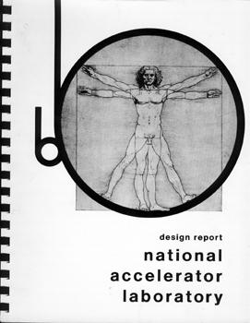

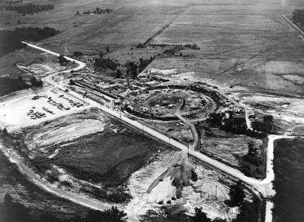
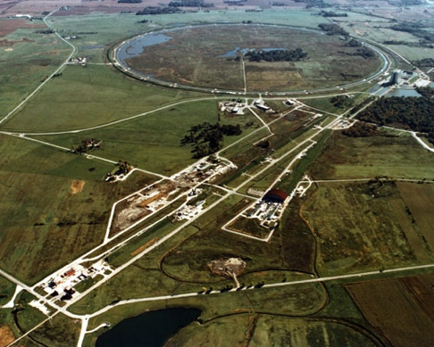
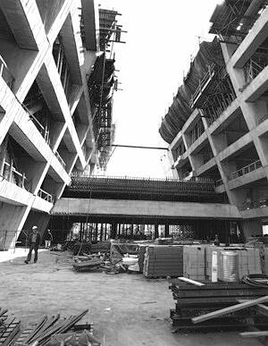
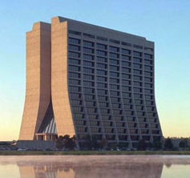
Fermilab: Early History
1963 – Committee chaired by Norman Ramsey recommends the construction of a 200 BeV synchrontron
to be located at Berkeley (of course)
1965 - Joint Committee on Atomic Energy (JCAE) and the National Academy of Sciences (NAS) endorse the Ramsey Report
but as a “National Accelerator Lab”, with a nation-wide site selection.
1966 – Weston, IL chosen as the site
1967 – Cornell physicist Robert Wilson named first director
1968 – Construction of NAL begins
1972 – First 200 GeV beam in the Main Ring (400 GeV later that year)
Extracted to three fixed target, experimental beam lines: Meson, Neutrino, and Proton
1974 – Iconic “High Rise” completed. Lab dedicated to Enrico Fermi, and renamed “Fermi National Accelerator Laboratory”
Fermi’s widow, Laura, attended the ceremony

Slide 3
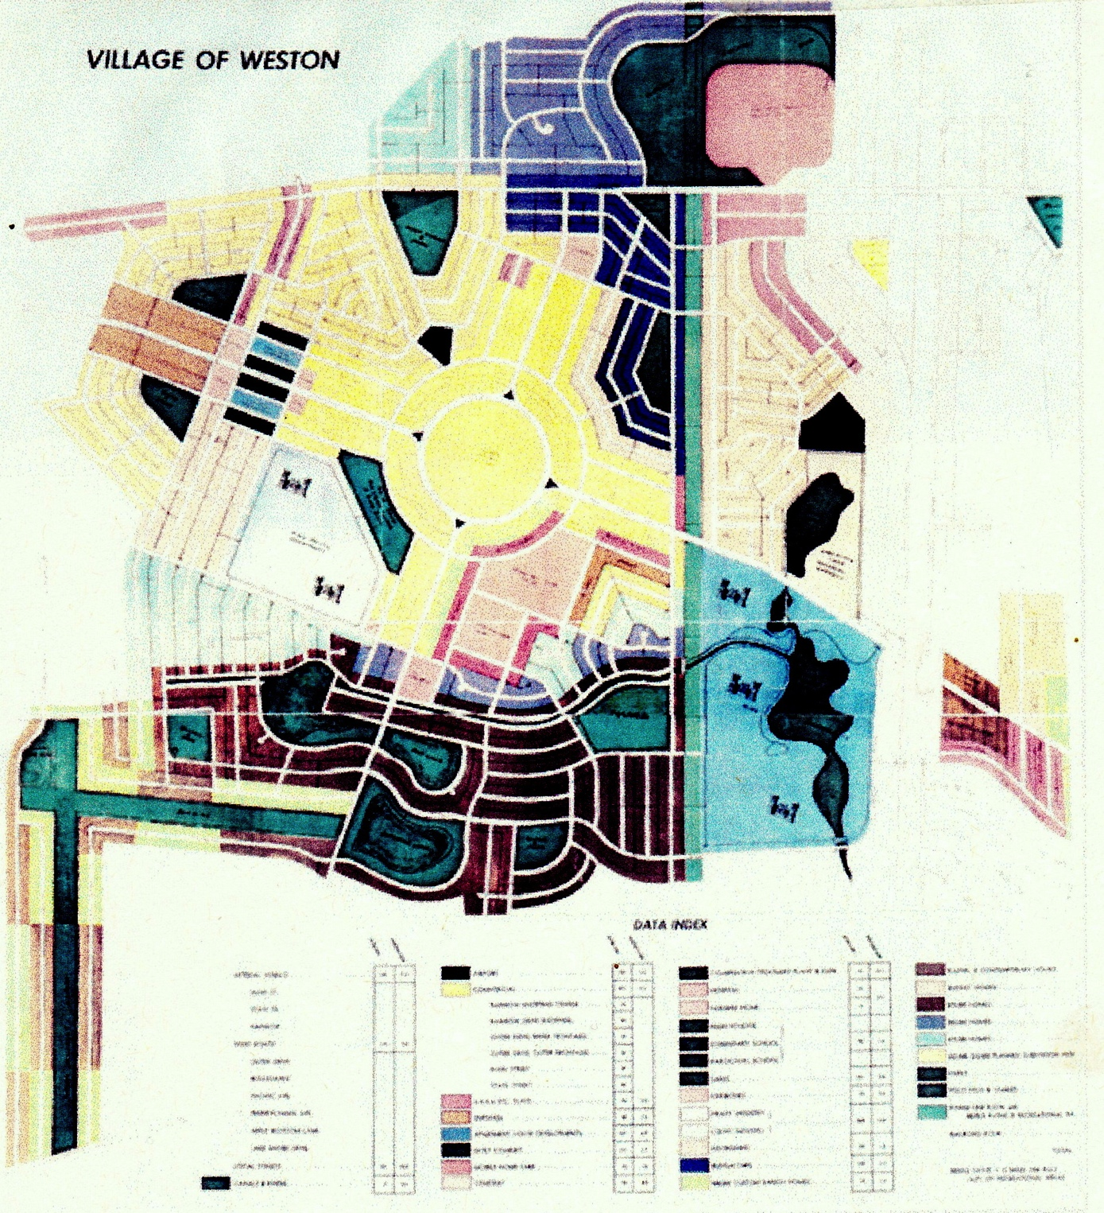

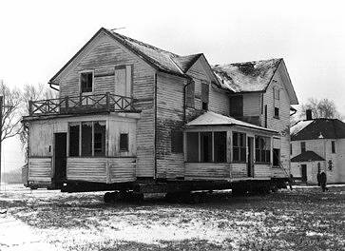
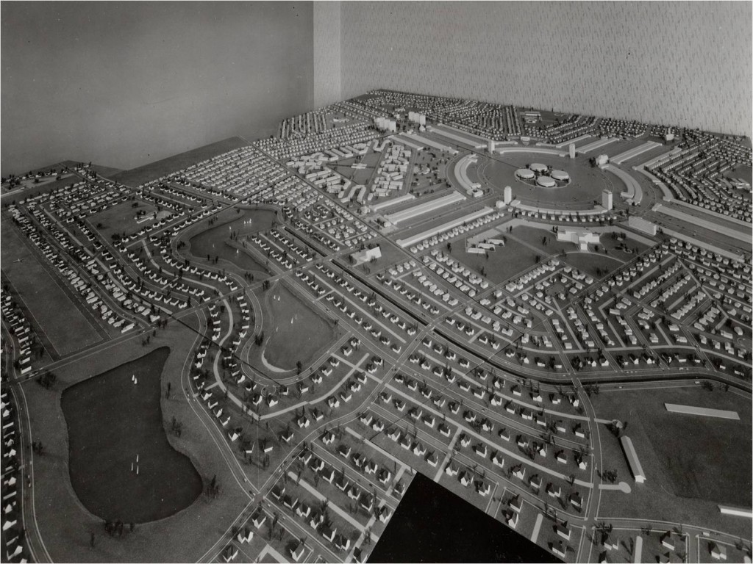
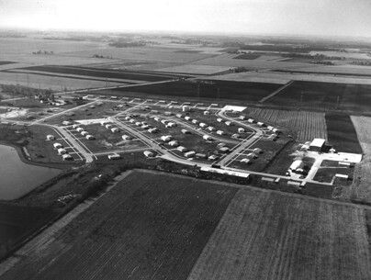
What Was Weston?
In 1964, developer William Riley began construction of Weston, IL, a planned community with houses, apartments, parks, churches, and shopping centers.
The development went bankrupt less than a year later, after the completion of only a small portion.
Local politicians convinced the state to propose the site for to the AEC for the new National Accelerator Lab
Residents did not realize they would have to move!
In 1996, Weston site was chosen out of 126 proposals with over 200 sites.
The small completed part became the Fermilab Village.
Since it was the 60s, the mob had of course been involved. Faced with bankruptcy and threats, Riley testified against them and subsequently disappeared into witness protection.
Note round thing in middle

Slide 4
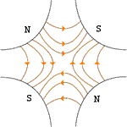
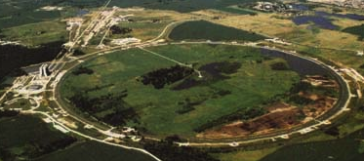

Main Ring: First Separated Function Synchrotron
Strong focusing was originally implemented by building magnets with non-parallel pole faces to introduce a linear magnetic gradient
=
+
dipole
quadrupole
CERN PS (1959, 29 GeV)
Later synchrotrons were built with physically separate dipole and quadrupole magnets. The first “separated function” synchrotron was the Fermilab Main Ring (1972, 400 GeV)
+
=
dipole
quadrupole
Fermilab

Slide 5
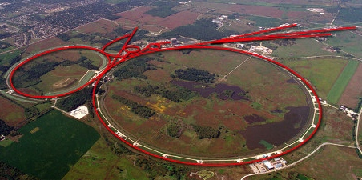
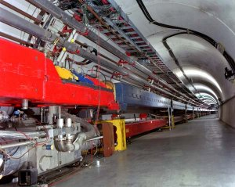
Tevatron: First Superconducting Synchrotron
From the beginning, Wilson was making plans for a superconducting ring to share the tunnel with the Main Ring
Dubbed “Saver Doubler” (later “Tevatron”)
1982 – Magnet installation complete
1985 – First proton-antiproton collisions observed at CDF (1.6 TeV CoM). Most powerful accelerator in the world for the next quarter century
Alternated collider and fixed target program.
1995 – Top quark discovery
Late 1990’s – major upgrades to increase luminosity, including separate ring (Main Injector) to replace Main Ring
Also removed extraction hardware to eliminate Tevatron fixed target program.
1999 – Tevatron Energy reaches 1.96TeV CoM energy
2011 – Tevatron shut down after successful LHC startup
Main Ring
Tevatron

Slide 6
Fermilab Firsts and Records
Firsts:
First separated function synchrotron:
Main Ring, 1972
First superconducting synchrotron/collider
Tevatron, 1983 (first collisions in 1986)
First permanent magnet storage ring
Recycler, 2000
Records:
Highest energy proton beam
Main Ring, 1972 (breaks AGS record)➔1983 (broken by Tevatron)
Tevatron, 1983-2008 (broken by LHC)
Highest energy hadron collider
Tevatron, 1986 (breaks SppS record)➔2009 (broken by LHC)
Highest hadronic luminosity
Tevatron, 2005 (broke ISR *p-p* record!) ➔ 2011 (broken by LHC)
Highest energy p-pbar collider
Tevatron, 1986 (breaks SppS record)➔ present
Highest p-pbar luminosity
Tevatron, 1992 (broke SppS record)➔ present

Slide 7
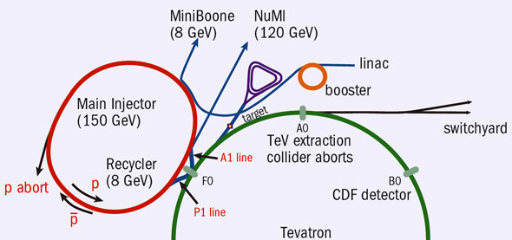
Fermilab Accelerator Complex Today
As LHC takes over the Energy Frontier, Fermilab focuses on intensity-based physics
Accumulator/Debuncher: Formerly for pBar accumulation, soon muon and proton manipulation (Delivery Ring)
Recycler: Formerly for pBar storage, now for proton pre-stacking
Neutrinos
/Noνa
~45 years old!
/400 MeV
/8 GeV
120 GeV+secondaries

Slide 8
Why Multiple Stages?
At low energies, space charge is trying to blow up beams, so you want to accelerate them as quickly as possible to energies where relativistic effects prevent this
➔start with a linear accelerator
The energy range of a single synchrotron is limited by
Beams get smaller as as they accelerate ( ), so an aperture large enough for the injected beam is unreasonably large at high field.
Hysteresis effects result in excessive nonlinear terms at low energy
Typical range 10-20 for colliders, larger for fixed target
Fermilab Main Ring: 8-400 GeV (50x)
Fermilab Tevatron: 150-980 GeV (6.5x)
LHC: 400-7000 GeV (17x)
Higher energy beams require multiple stages of acceleration, with high reliability at each stage
How is this done?

Slide 9
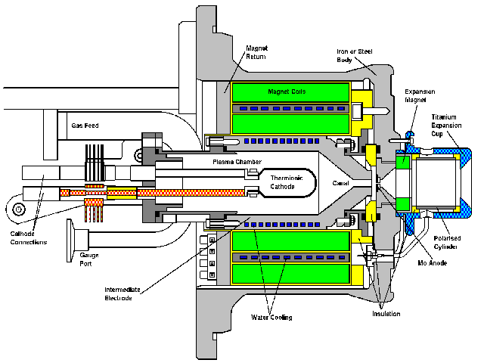
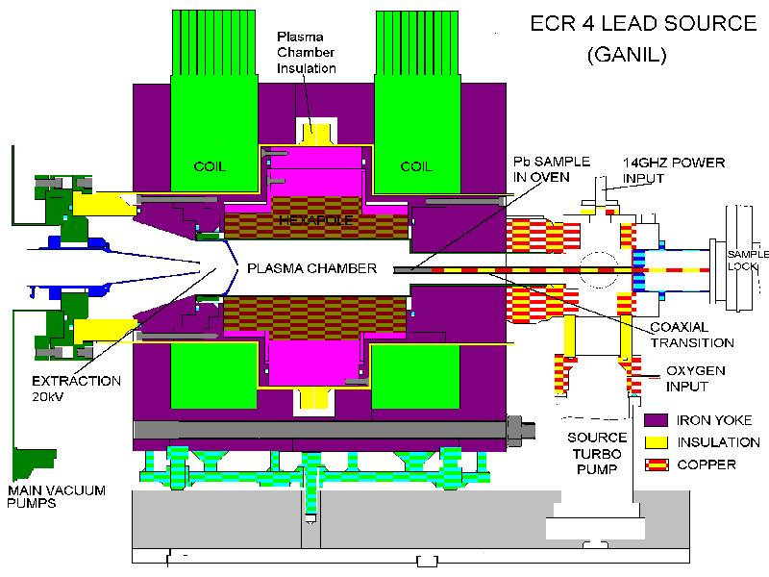
Getting started: Ion sources
CERN proton source
CERN Lead source
FNAL H- source. Mix Cesium with Hydrogen to add electron. (why? we’ll get to that)
Typically 10s of keV and mAs to 10s of mA of current. Want to accelerate as fast as possible before space charge blows up the beam!

Slide 10
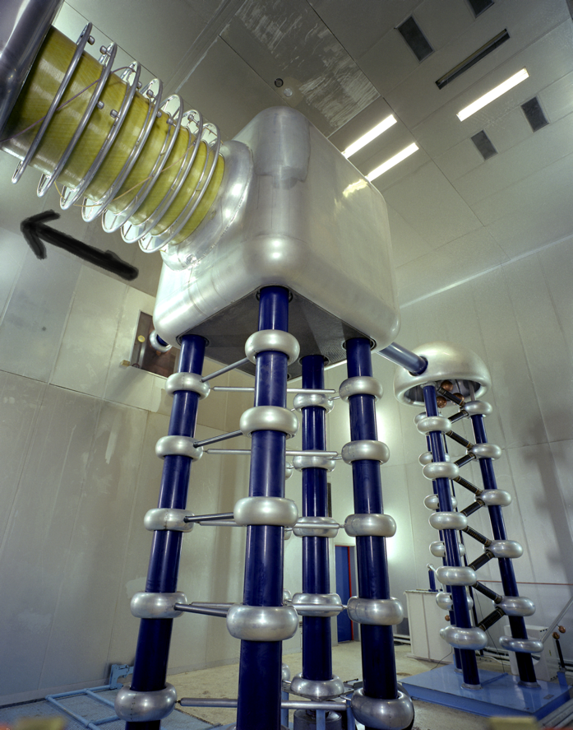
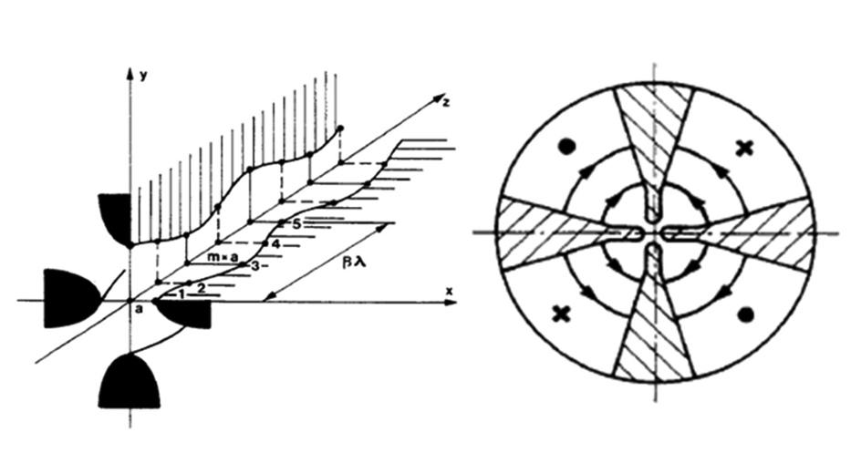
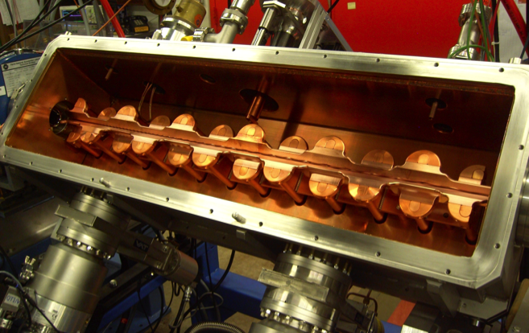
Initial Acceleration
Old: Static
New: RF Quadrupole (RFQ)
Static acceleration from Cockcroft-Walton. FNAL = 750 keV
max ~1 MeV
RF structure combines an electric focusing quadrupole with a longitudinal accelerating gradient.

Slide 11
(New) Fermilab Front End
The front end of any modern hadron accelerator looks something like this:
200 MHz RFQ: 35➔750 keV
Solenoidal focusing for low energy beam
beam
Redundant H⁻ sources: 0-35 keV
Medium Energy Beam Transport (MEBT, pronounced “mebbit”): 750 kEV
Low Energy Beam Transport (LEBT, pronounced “lebbit”): 35 keV

Slide 12
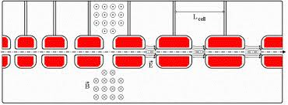
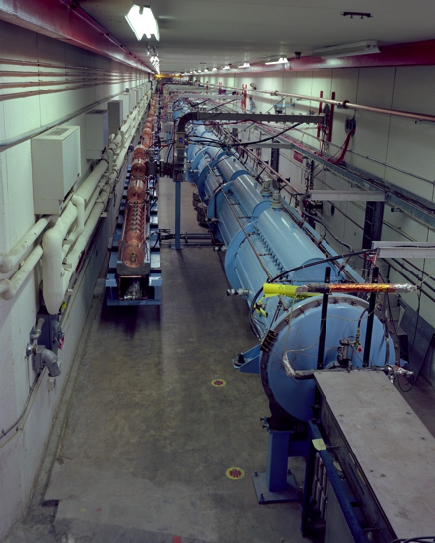
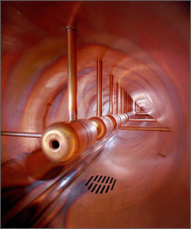
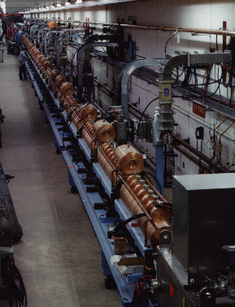
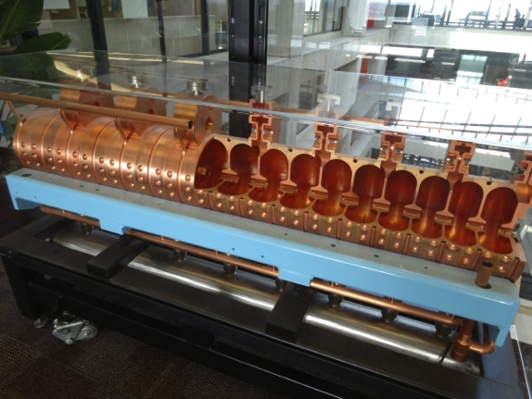
Linac (750keV➔400 MeV)
Because the velocity is changing quickly, the first linac is a 200 MHz Drift Tube Linac (DTL, aka “Avarez Linac”), which can be beta-matched to the accelerating beam.
Put conducting tubes in a larger pillbox, such that inside the tubes E=0
Bunch of pillboxes
Gap spacing changes as velocity increases
Drift tubes contain quadrupoles to keep beam focused
As energy gets higher, switch to 800 MHz “π-cavities”, which are more efficient (added in 1990s)
➔

Slide 13
Linac -> synchrotron injection
Eventually, the linear accelerator must inject into a synchrotron
In order to maximize the intensity in the synchrotron, we can
Increase the linac current as high as possible and inject over one revolution
There are limits to linac current
Inject over multiple (N) revolutions of the synchrotron
Preferred method
Unfortunately, Liouville’s Theorem says we can’t inject one beam on top of another
Electrons can be injected off orbit and will “cool” down to the equilibrium orbit via synchrotron radiation.
Protons can be injected a small, changing angle to “paint” phase space, resulting in increased emittance
Linac emittance
Synchrotron emittance

Slide 14
Ion (or charge exchange) injection
Magnetic chicane pulsed to move beam out during injection
Circulating Beam
Beam at injection
H⁻ beam from LINAC
Stripping foil
Instead of ionizing Hydrogen, and electron is added to create H⁻, which is accelerated in the linac
A pulsed chicane moves the circulating beam out during injection
An injected H⁻ beam is bent in the opposite direction so it lies on top of the circulating beam
The combined beam passes through a foil, which strips the two electrons, leaving a single, more intense proton beam.
Fermilab was converted from proton to H⁻ during the 70’s (present chicane uses three magnets)
CERN still uses proton injection, but is in the process of upgrading (LINAC4 upgrade)
Unfortunately, this can only be done once!

Slide 15
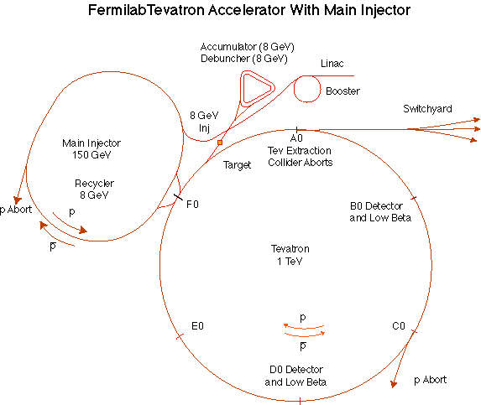
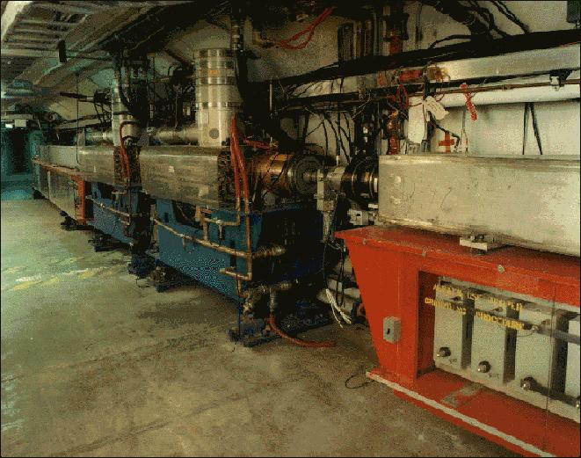
Booster
Accelerates the 400 MeV beam from the Linac to 8 GeV
Operates in a 15 Hz offset resonant circuit
Cannot alter beam structure
That’s why Mu2e needs other rings
Sets fundamental clock of accelerator complex!
More or less original equipment
45+ years old
Supplying beam to neutrino program and Mu2e will require ~doubling output
Hardware limits ➔ Improve RF system
Radiation limits ➔ Improve acceleration efficiency to reduce losses.
➔ “Proton Improvement Plan” (whole separate talk)

Slide 16
Injection and extraction from synchrotrons
After the initial ion injection, protons must be transferred all at once.
We would ideally like to extract (or inject) beam by switching a magnetic field on between two bunches (order ~10-100 ns)
Unfortunately, getting the required field in such a short time would result in prohibitively high inductive voltages, so we usually do it in two steps:
fast, weak “kicker”
slower (or DC) extraction magnet with zero field on beam path.
Injection is just extraction in reverse

Slide 17
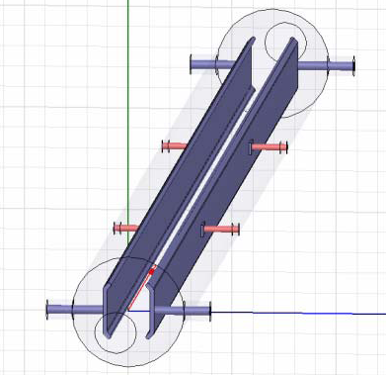
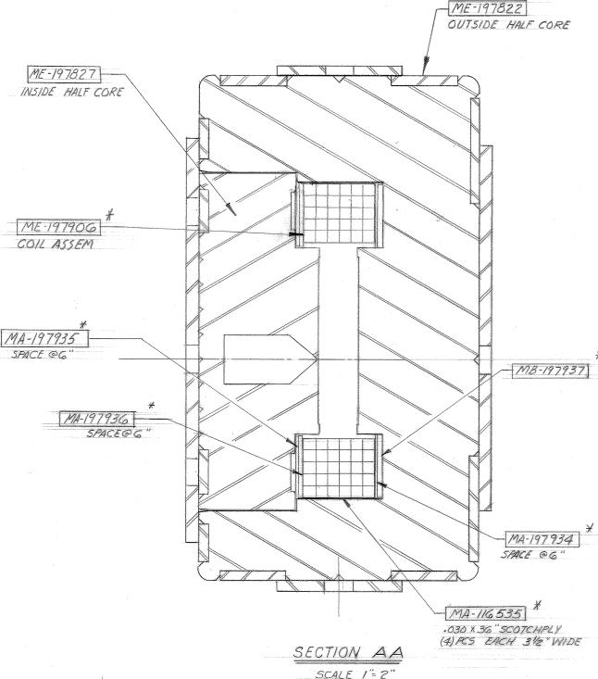
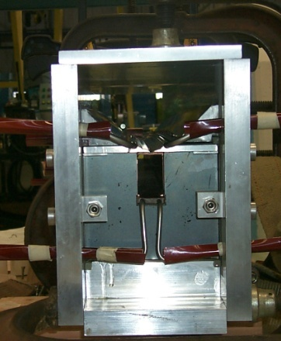
Extraction hardware
“Fast” kicker
usually an impedance matched strip line, with or without ferrites
“Slow” extraction elements
“Lambertson”: usually DC
Septum: pulsed, but slower than the kicker
circulating beam (B=0)
circulating beam (B=0)
B
current “blade”
B
return path
At Fermilab, the Booster septum transfers to the Main Injector Lambertson

Slide 18
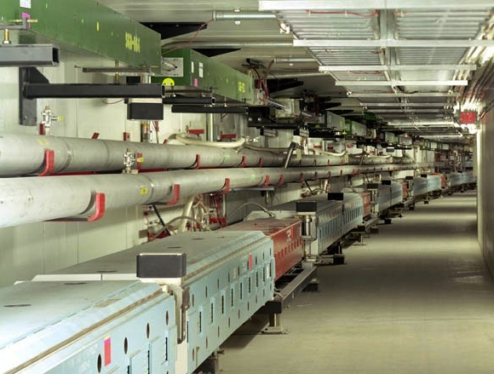
Main Injector/Recycler
Main Injector
Accelerates protons (or pBars) from 8 GeV to 120 or 150 GeV
Can hold up to 12 Booster batches
Recycler
Permanent magnet 8 GeV storage ring
During Tevatron program, used to store pBars
All particles had to pass through Main Injector first!
Currently being configured to pre-stack protons for loading into the Main Injector
In the future, it will be used to re-bunch protons for the g-2 and Mu2e experiments.

Slide 19
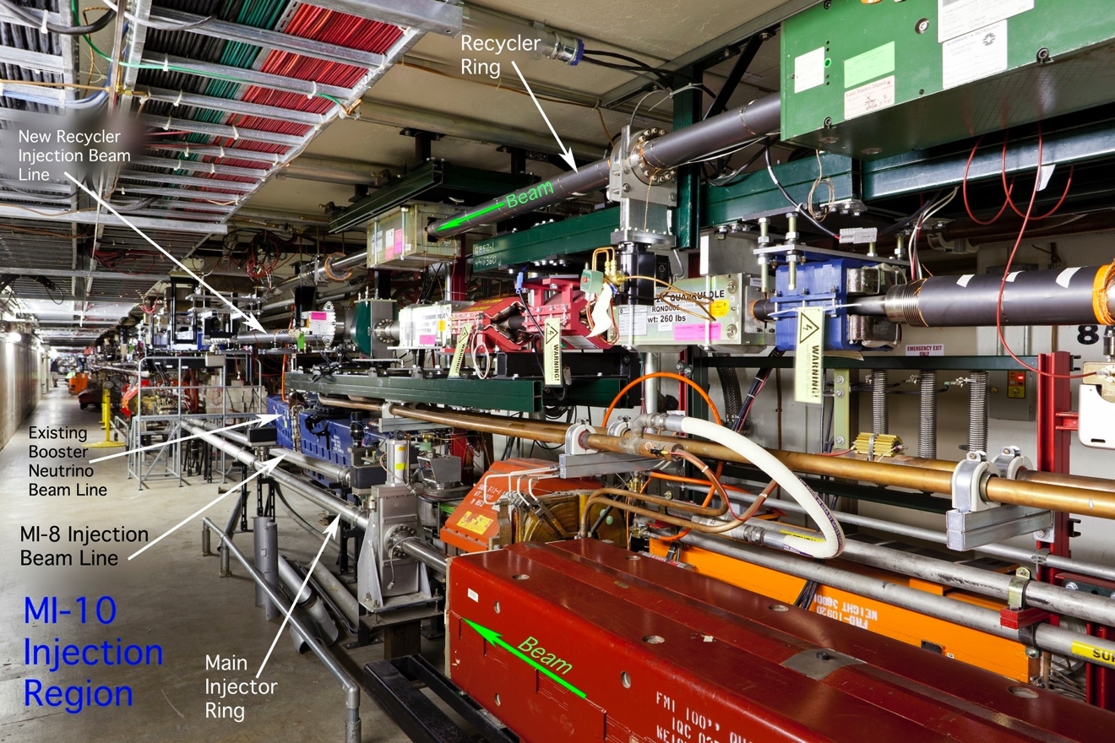
A Tight Fit

Slide 20
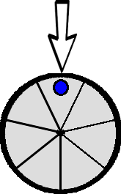
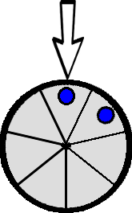
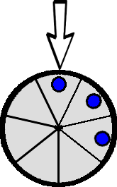
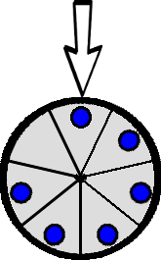
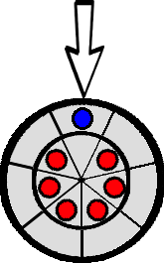
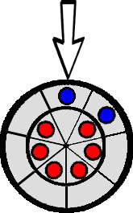
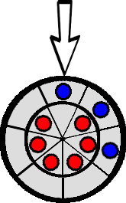
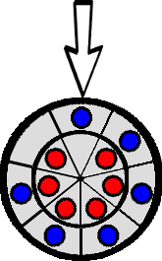
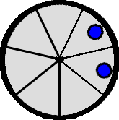
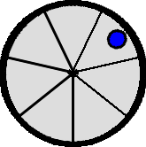
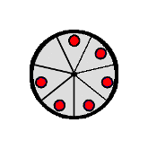
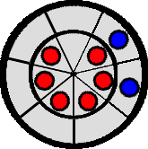
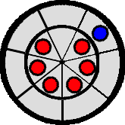
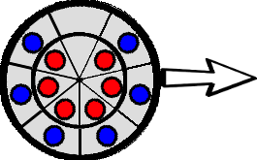
Box Car Stacking/ Slip Stacking
The Recycler and Main Injector are 7 times the circumference of the Booster
There are 7 “slots” to inject Booster batches
One bunch is injected into one of the 7 slots
This process can continue until up to 6/7 slots are filled (“boxcar stacking”).
At this point, we can accelerate and extract the beam, or…
Decelerate these bunches slightly
Inject a new batch is injected into the empty slot.
Because it it a slightly different velocity it will “slip” relative to the other bunches.
Continue until there are 6 double bunches, which can then be accelerated and extracted.
Note: two is the limit because of momentum aperture.
`
Slip stacking was done in the Main Injector to increase protons to pBar and NuMI
Being commissioned in Recycler

Slide 21
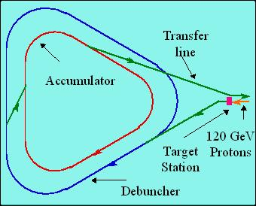
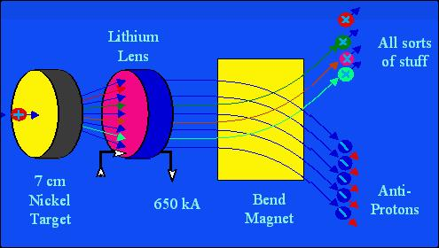
Fermilab Antiproton Source: OBSOLETE
120 GeV protons strike a target, producing many things, including antiprotons.
a Lithium lens focuses these particles (a bit)
a bend magnet selects the negative particles around 8 GeV. Everything but antiprotons decays away.
pBars were “stacked” in the two part Accumulator/Debuncher rings
Later “stashed” in Recycler
Took ~1 day to make enough Pbars for one Tevatron “store”, which lasted a day
“Stack and Store” cycle
The Accumulator ring will be dismantled for parts, and the Debuncher Ring (➔”Delivery Ring”) will be re-tasked for g-2 and Mu2e.

Slide 22
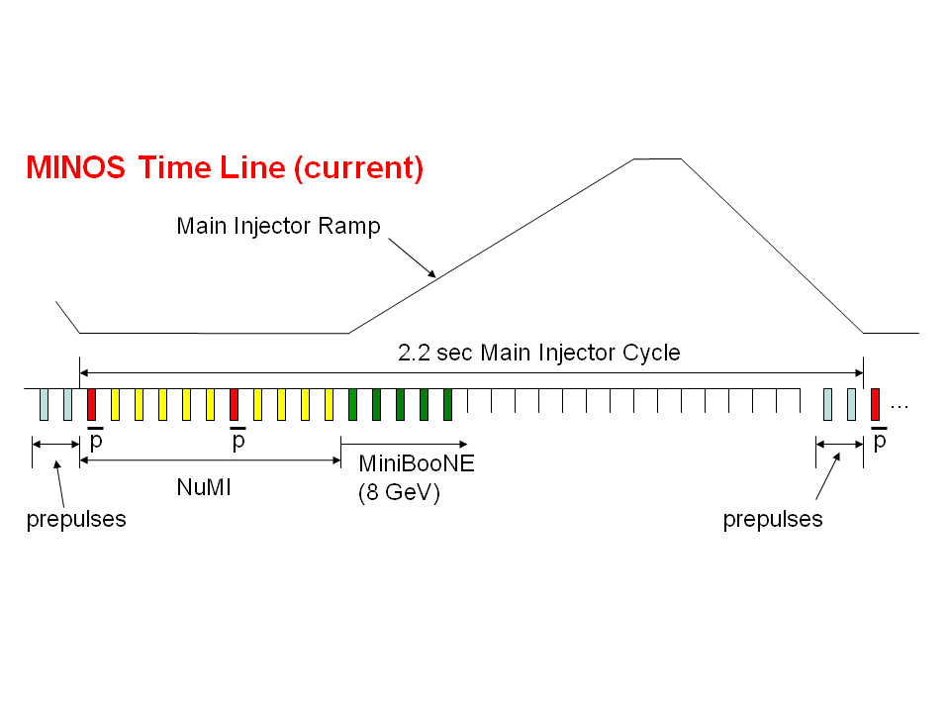
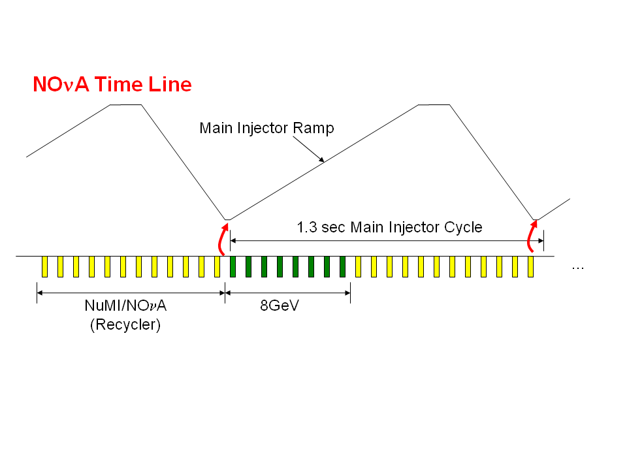
NOνA Time Line Improvements
300 kW
Tevatron era: must allow time at injection energy to load protons into Main Injector
700 kW
Upgrade: a new transfer line will allow us to “prestack” in the Recycler
Up to ~5x10²⁰ protons/year that cannot be used by NOνA

Slide 23
Resonant Extraction
Some experiments don’t want all the beam at once.
Use nonlinear magnets to drive a harmonic instability
quadrupoles➔half-integer: Main Ring, Tevatron, Main Injector (120 GeV Program)
sextupoles➔third-integer: Delivery Ring for Mu2e
Extract unstable beam as it propagates outward
Standard technique in accelerator physics
Use electrostatic septum followed by Lambertson
Lambertson
Unstable beam motion in N(order) turns
Extraction Field
Extracted beam
Lost beam
Wire or foil plane

Slide 24
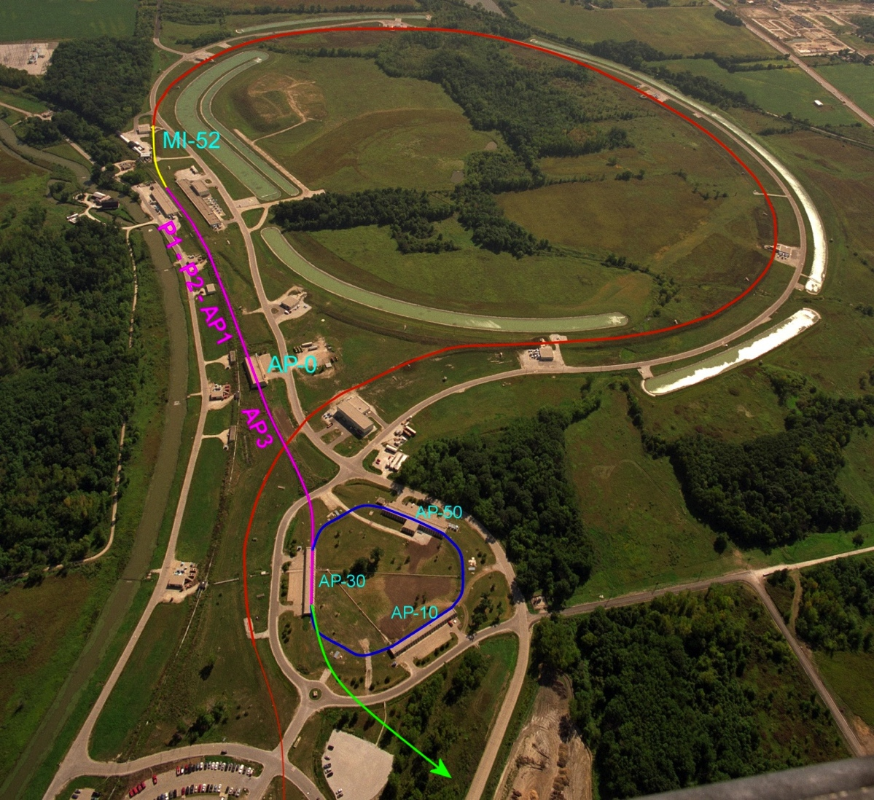

g-2 and Mu2e Proton Delivery
Common to both:
One Booster “batch” is injected into the Recycler (8 GeV storage ring).
4x10¹² protons
1.7 μsec long
It is divided into 4 bunches of 10¹² each
g-2:
Bunches are extracted to a muon production target (former pBar target location)
Muons circulate in Delivery Ring until all pions decay away
Muons are extracted to g-2 precession ring (transported from Brookhaven)
Mu2e:
Bunches are extracted directly to the Delivery Ring
Period = 1.7 μsec
As each bunch circulates, it is resonantly extracted to produce the desired beam structure.
Bunches of ~3x10⁷ protons each
Separated by 1.7 μsec
Main Injector/Recycler
Delivery Ring (formerly pBar Debuncher)
Mu2e
Booster

Slide 25

120 GeV Program
Primary and secondary beams. Support for test beams and HEP experiments: MIPP, SeaQuest, etc.
120 GeV beam from the Main Injector passes through a stub of the original Main Ring in the Tevatron Tunnel

Slide 26
Beam Delivery to SeaQuest
Once a minute, 6 booster batches are loaded into the Main Injector
These resonantly extracted over 5 seconds through the Main Ring stub, through the Switchyard to SeaQuest
Time substructure
~81 53 MHz bunches

Slide 27
Controlling the Complex
The Booster resonant circuit sets a fundamental clock for the complex: 15 Hz
Protons can be arbitrarily routed and handled at the level of one Booster “batch”
Size controlled by length of linac injection
1-15 “turns” ≈ 0.3-4.5x10¹² protons
1.6 μsec train of 53 MHz bunches.
Smaller or shorter extractions can be made by phasing the extraction and dump kickers to extract a partial batch
Very wasteful: historically used for loading Tevatron protons
Each machine handles protons based on a two digit hexadecimal “Event Reset”, produced by the Time Line Generator
Generally Linac: $01-$0F, Booster: $10-$1F, Main Injector: $20-$2F, Switchyard: $30-$3F, etc
Examples
Linac studies: $0A
MiniBooNE: $0F➔$1D
NuMI: $0F➔$17➔$23
Can have multiple clock types in a cycle to control different parts of, eg, Main Injector Ramp

Slide 28

Proton Demands
~80kW @ 8 GeV
Slow extraction experiments take a tiny fraction of the protons, but take a significant fraction of the timeline from other experiments
SeaQuest uses about .4% of the protons NuMI does, but results in a 3.3% reduction in the protons to NuMI.

